Slide 1
Discussion Section (Week 3)
CSCI 561 - Foundation for Artificial Intelligence
Prof Wei-min shen shen@isi.edu

Slide 2
Outline
Optimization Techniques
Local search
Hill-Climbing. Gradient-Descendent
Simulated Annealing
Genetic Algorithm
…
Game Playing

Slide 3
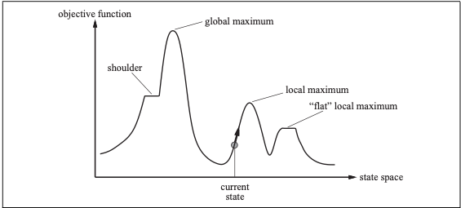
Optimization One of the most fundamental Problems
What is optimization?
All (almost) engineering/AI problems are optimizations! Why?

Slide 4
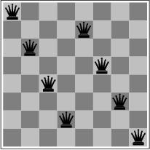
Hill Climbing
What are the advantages and disadvantages of classical hill-climbing?
Can you think of real-world examples where hill-climbing would be particularly good?
What about bad?
Notes:
The success of hill climbing depends very much on the shape of the state-space land- scape: if there are few local maxima and plateaux, random-restart hill climbing will find a good solution very quickly. On the other hand, many real problems have a landscape that looks more like a widely scattered family of balding porcupines on a flat floor, with miniature porcupines living on the tip of each porcupine needle, ad infinitum. NP-hard problems typi- cally have an exponential number of local maxima to get stuck on. Despite this, a reasonably good local maximum can often be found after a small number of restarts.

Slide 5
Key Questions
How big is your step?
You “walk”, but do you “jump”? When? How far?
When do you stop?
Is you technique deterministic and complete?

Slide 6
Simulated Annealing
The AIMA book says that simulated annealing is complete (page 125).
In real-world applications will that be true?
Why or why not?

Slide 7
http://toddwschneider.com/posts/traveling-salesman-with-simulated-annealing-r-and-shiny/

Slide 8

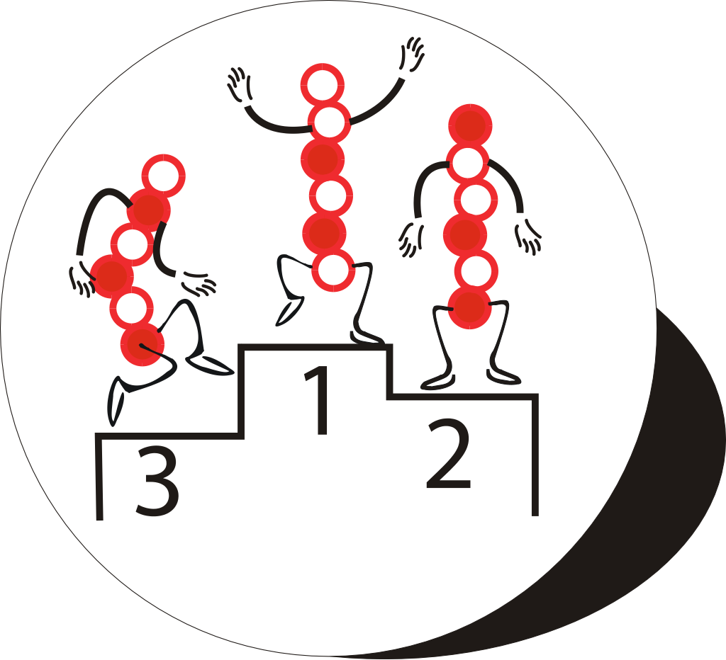
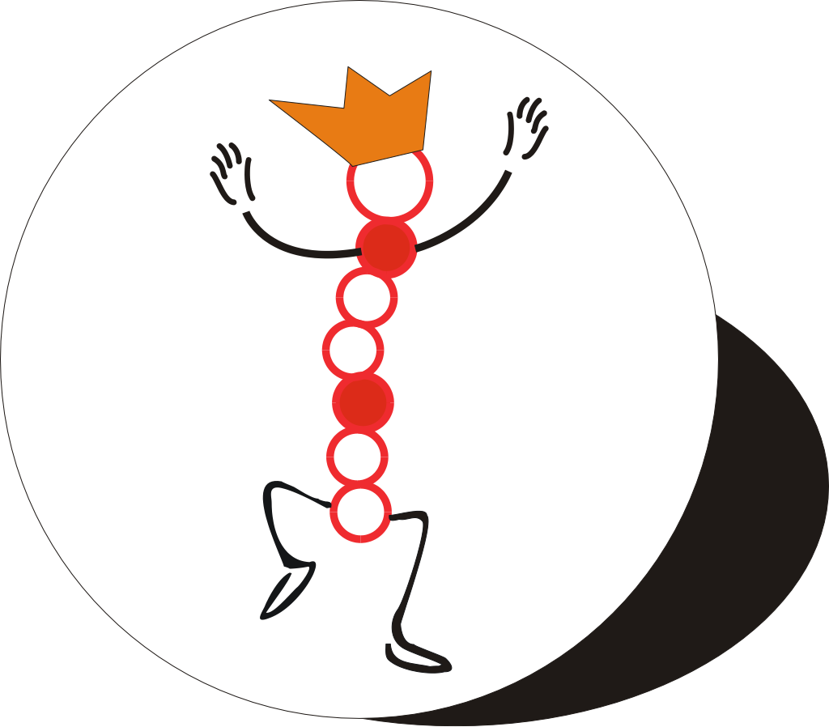
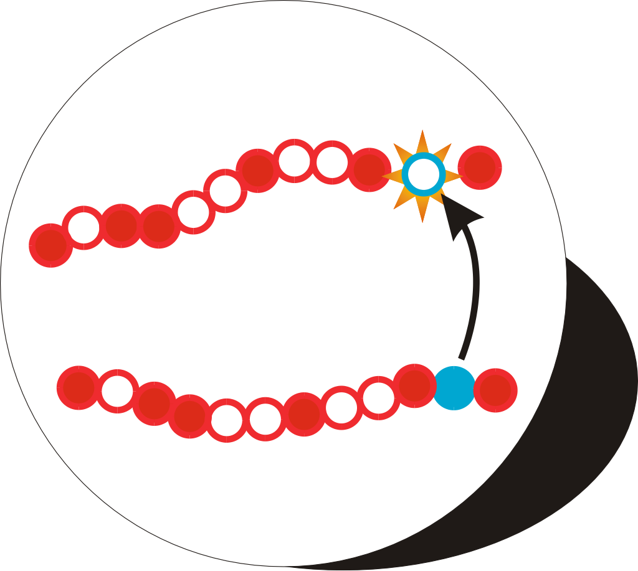
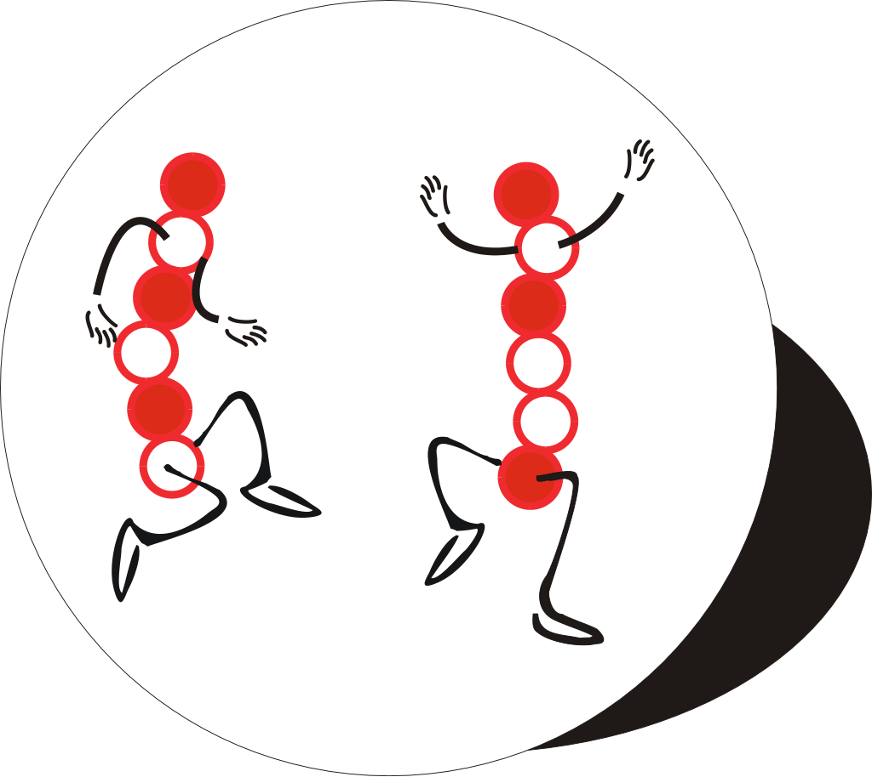
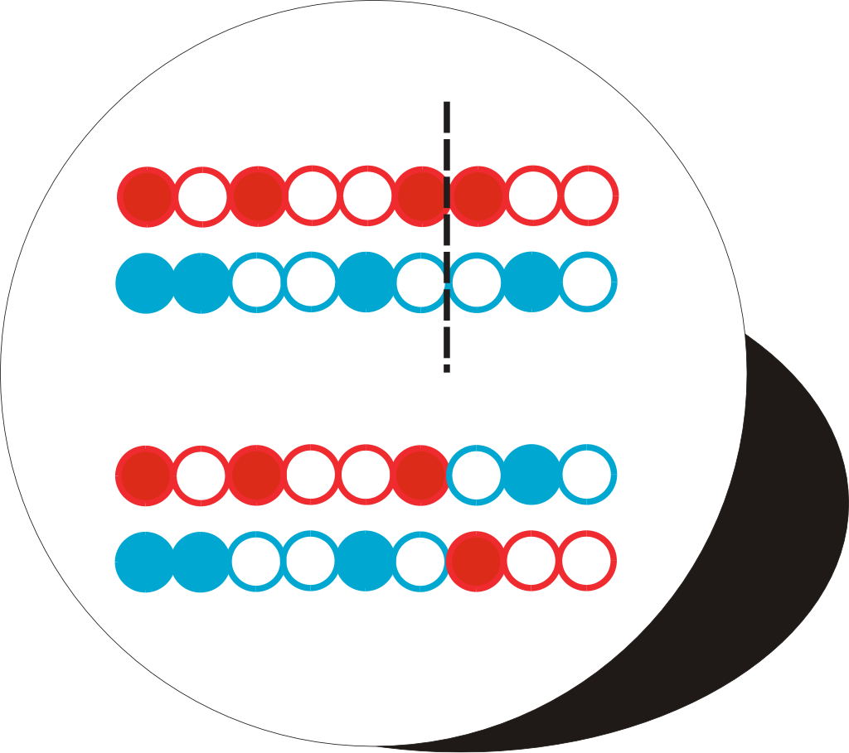
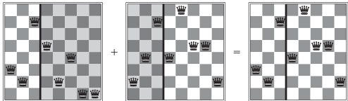
The Genetic Algorithm Cycle
New Population
Fitness
Selection
Mutation
Crossover
Notes:
Summary of the previous steps to the model.
Populations are continuously produced, going round the outer loop of this diagram, until the desired amount of optimisation has been achieved.

Slide 9
Adversarial Search
MAX
x
o
x
o
x
o
win
lose
x
o
x
x
o
x
x
o
x
MIN
draw
x
o
x
o
x
o
x
o
x
o
x
o
x
o
x
x
o
x
x
o
x
x
o
x
x
o
x
x
o
x
MAX
x
o
x
x
o
x
o
o
x
o
x
o
o
x
o
x
o
o
o
o
x
o
x
o
o
x
o
o
x
o
x
o
x
x
o
x
x
o
x
x
o
x
x
o
x
o
o
x
o
o
x
x
o
x
o
x
o
x
x
o
x
x
o
o
x
o

Slide 10
Minimax Algorithm
MAX
6
α: at least max can get this much
β: at most min will give this much
Update [α, β], cut if v is out range
MIN
6
-8
-9
15 10 6 12 -8 7 5 25 -9
Notes:
When the minimax algorithm visits the rightmost node on the 2nd level, it knows that MAX can already get at least 6 from somewhere else, so when MIN offers a 5 there, the algorithm does not need to care about the rest of the nodes, 25 and -9, so it cuts them.

Slide 11
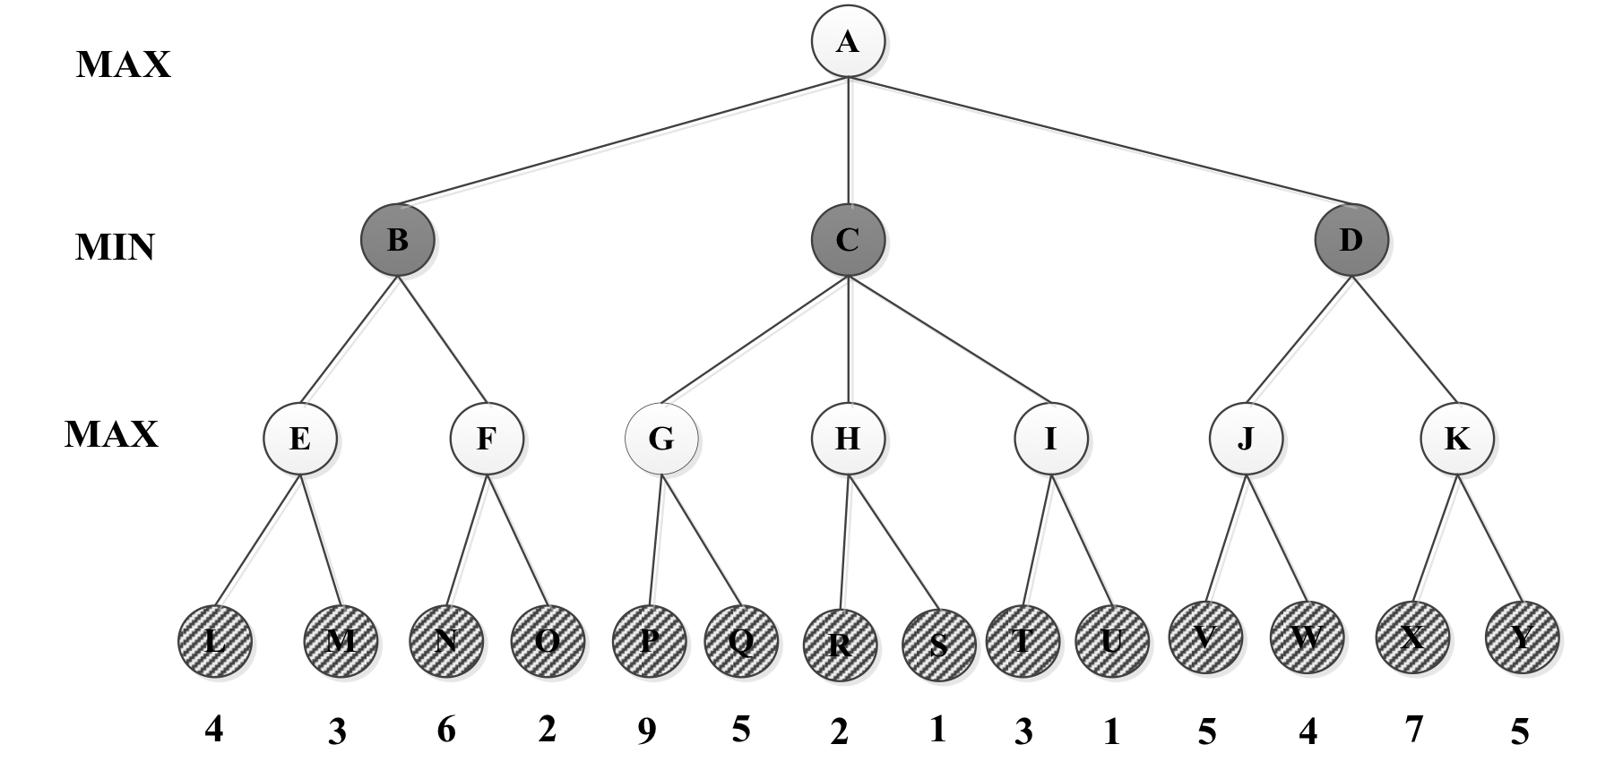
α: at least max can get this much
β: at most min will give this much
Keep update [α,β], if v is not in the range, then cut the branches
=5
β = +∞
v = 5
=-∞
β = +∞
v = -∞
=4
β = +∞
v = 4
= 4
β = +∞
v = ∞
= 4
β = 9
v = 9
= 4
β = 9
v = 2
= 4
β = +∞
v = ∞
=-∞
β = +∞
v = ∞
= 4
β = 5
v = 5
=-∞
β = 4
v = 4
=4
β = ∞
v = -∞
=9
β = ∞
v = 9
=4
β = +∞
v = 4
=-∞
β = +∞
v = -∞
=4
β = +∞
v = 4
=4
β = 5
v = -∞
=4
β = 9
v = -∞
=4
β = ∞
v = -∞
=4
β = 5
v = 7
=-∞
β = 4
v = -∞
=4
β = 9
v = 2
=5
β = ∞
v = 5
=-∞
β = 4
v = 6
Max Node
Min Node

Slide 12
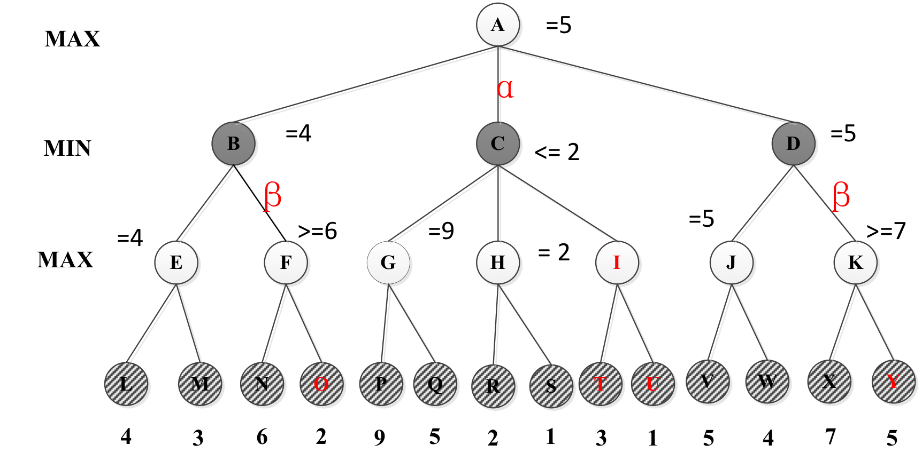

Slide 13
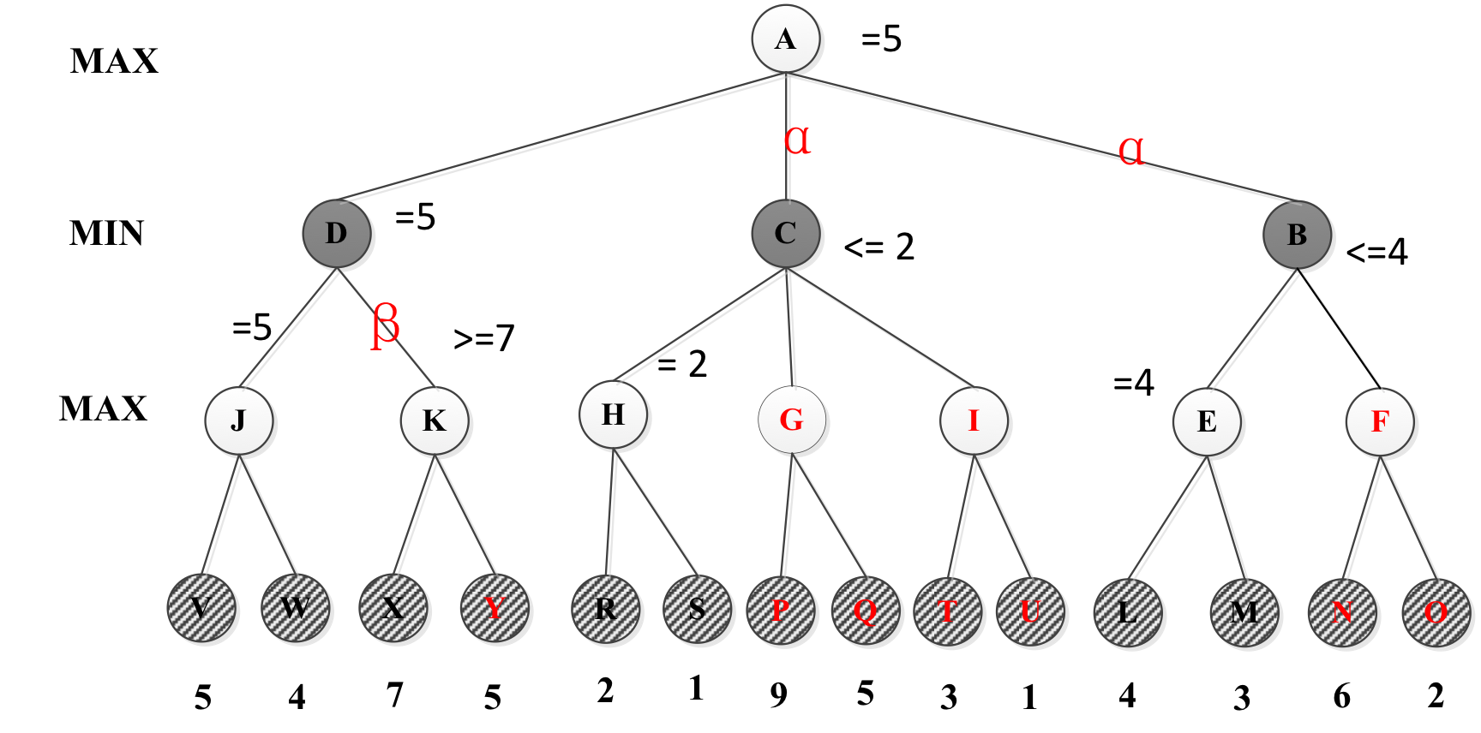

Slide 14
What you should know
What are the characteristics of local search? Is it complete? Optimal? Time and Space complexity?
What problem domains are well-suited to each type of search technique? Ill-suited? Why?
Know how to compare their performance in general and in a specific domain or problem.
What is the difference between uninformed and informed search? Which ones are optimal?
What are the advantages and disadvantages of depth-first search?
Why does a search heuristic need to be “admissible”?
What are the characteristics of Adversarial Search?
Why is meta-reasoning important in adversarial search?
Notes:
http://cse.unl.edu/~choueiry/S03-476-876/searchapplet/
https://courses.cs.washington.edu/courses/cse473/06sp/MazeRunnerDemo/search/applet.html
http://www.briangrinstead.com/files/astar/
http://www.cs.rmit.edu.au/AI-Search/Product/

Slide 15
CSP Example: Map Coloring
NT
NT
Q
Q
WA
WA
SA
SA
NSW
NSW
V
V
T
T
7 variables {WA,NT,SA,Q,NSW,V,T}
Each variable has the same domain {red, green, blue}
No two adjacent variables have the same value:
WA≠NT, WA≠SA, NT≠SA, NT≠Q, SA≠Q, SA≠NSW, SA≠V,Q≠NSW, NSW≠V

Slide 16
Backtracking Search: Map Coloring
{}
WA=red
WA=green
WA=blue
WA=red
NT=green
WA=red
NT=blue
NT
Q
WA
WA=red
NT=green
Q=red
WA=red
NT=green
Q=blue
SA
NSW
V
T

Slide 17
Constraint Propagation
Which variable X should be assigned a value next?
In which order should its values be tried?
Variable Selection:
“Most constrained variable” or “Minimum Remaining Values”
Degree: variable involved in most constraints on others (tiebreaker)
Value Selection:
Least constraining value
NT
NT
Q
WA
WA
SA
NSW
V
{blue}
T

Slide 18
When to use CSP Techniques?
When the problem can be expressed by a set of variables with constraints on their values
When constraints are relatively simple (e.g., binary)
When constraints propagate well (AC3 eliminates many values)
Local Search: when the solutions are “densely” distributed in the space of possible assignments

Slide 19
Want more?
Check out these demos:
http://toddwschneider.com/posts/traveling-salesman-with-simulated-annealing-r-and-shiny/
http://codecapsule.com/2010/04/06/simulated-annealing-traveling-salesman/
http://www.biostat.jhsph.edu/~iruczins/teaching/misc/annealing/animation.html
http://math.hws.edu/eck/jsdemo/jsGeneticAlgorithm.html
http://rednuht.org/genetic_walkers/
http://rednuht.org/genetic_cars_2/
Alpha-beta search demo:
https://www.yosenspace.com/posts/computer-science-game-trees.html
A* and heuristics:
http://www.briangrinstead.com/files/astar/
Practice Exercises: Chapter 4: # 4.1, Chapter 6: # 6.1, 6.5

